Slide 1
TEACHER CUE
CFU
HINT
Scaffolding for students
MAKE THE CONNECTION
Allow students to make the connection

Slide 2
We will be able to understand the information provided by studying rocks
TRACK WITH ME
READ WITH ME
I can discuss the information geology provides
I can name and describe each layer of the Earth

Slide 3
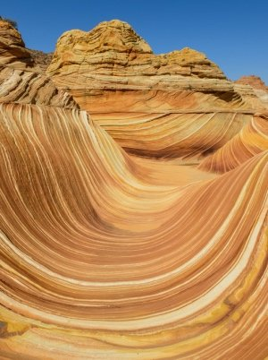
Geology
Is the study of the Earth, how it works and its history
https://www.youtube.com/watch?v=fJUXQvEgfVQ

Slide 4
MAKE THE CONNECTION
What thing on Earth tells us about the history of life
What information can geology provide?
By studying the rocks and minerals on Earth and how they behave we are able to learn about:
History of the Earth
History of life on Earth
Changes in climate
Resources and minerals
Natural disasters such as earthquakes, landslides, floods and volcanic eruptions
Notes:
Put up on board in cornell notes version

Slide 5
TEACHER CUE
CFU
What information can geology provide?

Slide 6
How old is the Earth?
The Earth is …..

Slide 7
How old is the Earth?
The Earth is….
4.53 billion years old

Slide 8
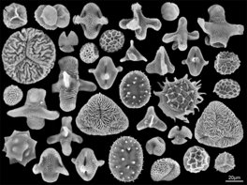
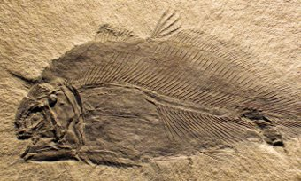
How can Geology tell us about life on Earth?
Pollen trapped in rocks tells us about different vegetation that was present at different times in our past.
Fossils are skeletons of animals and plants that have been preserved at different points in time.

Slide 9
HINT
Vary = can be very different
How can Geology tell us about changes in past climates?
Looking at fossils that are preserved the shells and organisms vary. This means that we can tell the climate through fossils.
These can also tell us whether the climate was wet or dry.

Slide 10
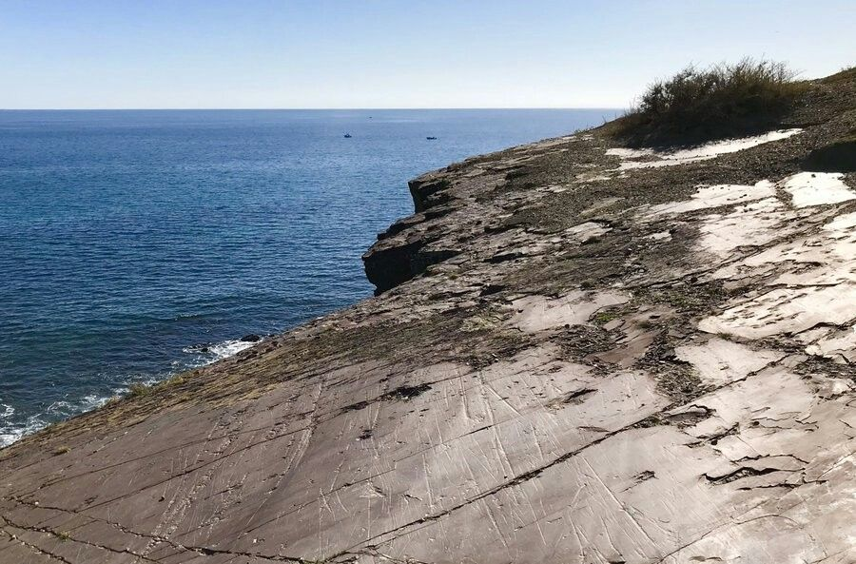
Some other ways geology can tell us about a climate….
If the rock has high amounts of salt, this tells us the climate was hot and dry due to fast evaporation of the water.
If the rock contains scratch marks this can tell us that ancient glaciers have been present and created these marks
Notes:
This photo is from Hallett Cove in Adelaide

Slide 11
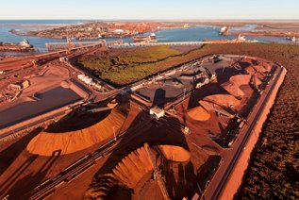
Some other ways geology can tell us about a climate….
Rocks in hot deserts (or have been in the past) are often a red colour with Iron deposits.
Iron ore in this image has made us $100 billion dollars in exports so far!

Slide 12
How can rocks help us understand about natural hazards?
By studying the types of rocks and the layers we can find fault lines that earthquakes occur along.
Rocks can also tell us how vulnerable a place is to landslides and flooding.
Finally rocks created from volcanoes are also used as a important resource.

Slide 13
Fossils are the ______________ of animals and plants present at that point in time.
The climate of NW WA is currently hot and dry. What substance would we expect to see in high amounts in rocks?
What causes the scratch marks along rocks that are in seen in Australia?
What mineral gives rocks a red colour in the in hot dry deserts?

Slide 14
Layers of the Earth
What are the main layers of the Earth that you remember?

Slide 15
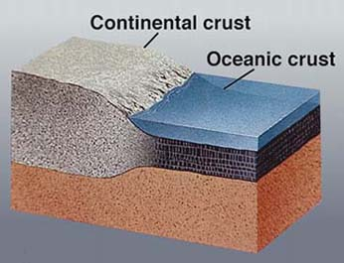
The crust
The crust id the solid outer layer that is made up of oceanic and continental crust.
Oceanic crust is made up of heavier minerals and sinks below the lighter thicker continental crust.
The crust is only 5-70 km thick!

Slide 16
Which is heavier?
Oceanic Continental

Slide 17
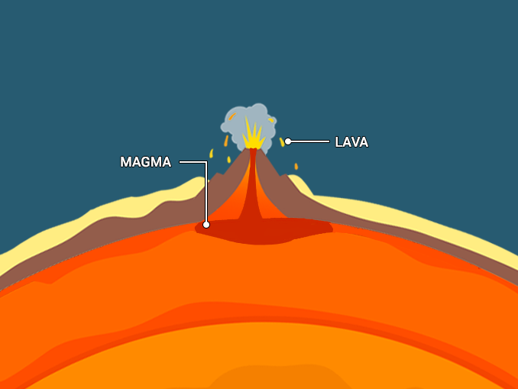
HINT
Convection currents are where the hot liquids and gases rise and the cooler substances sink
The mantle
The mantle is the thickest layer and is around 2886 kilometers thick. Convection currents in the mantle cause the Earth’s tectonic plates to move. Rocks in this layer are partially melted and move very slowly.
This layer is so thick it makes up 84% Earth by volume!
https://www.youtube.com/watch?v=KtexwZeUk7w

Slide 18
Name one interesting fact about the mantle
Magma is ________ the surface
Lava is _________ the surface
The mantle is 1000ºC to 3700ºC!

Slide 19
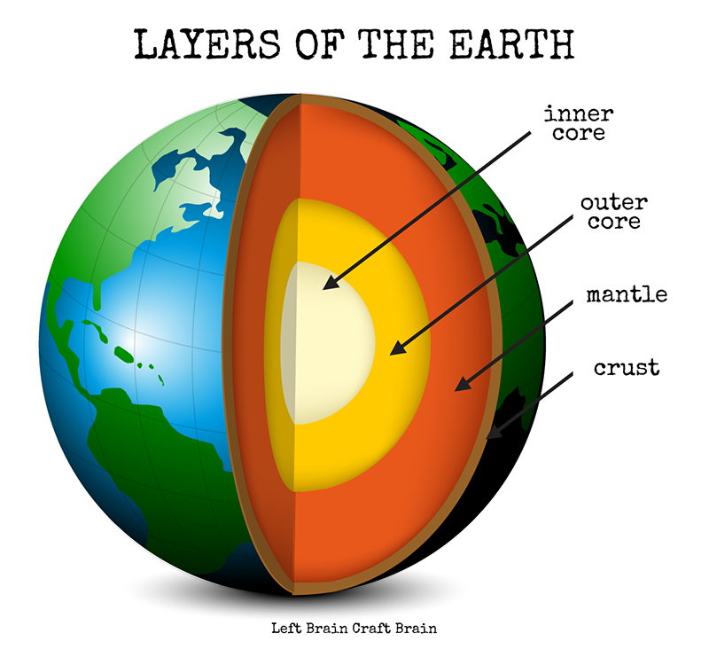
Outer Core
This outer core is a liquid layer of iron, nickel, sulphur and oxygen that is 4000-6000ºC. The outer core is 2260 km thick. This layer is liquid.

Slide 20
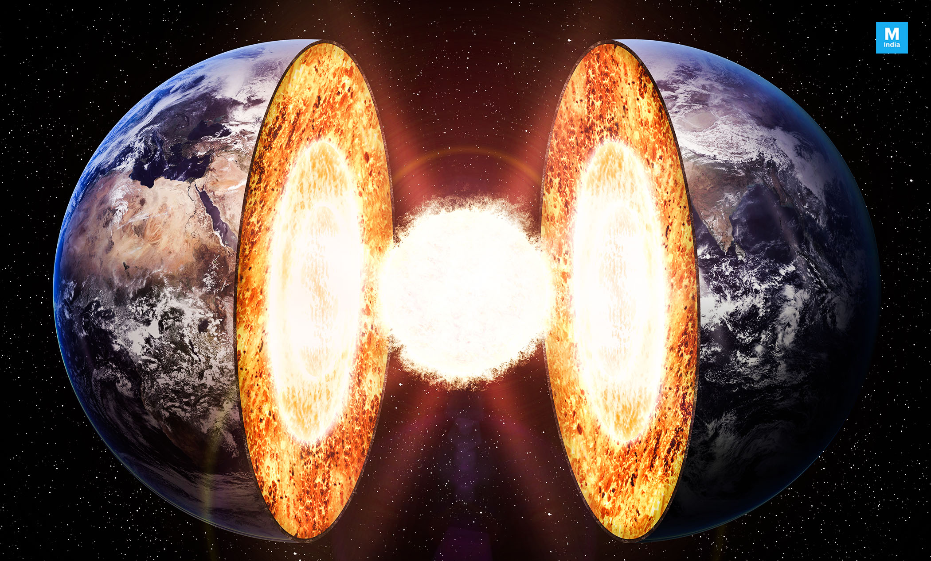
Inner Core
This layer is like a huge metal ball of iron and Nickel. It is solid and 5000-6000ºC. It is also over 2400 km thick.

Slide 21
We will be able to understand the information provided by studying rocks
TRACK WITH ME
READ WITH ME
I can discuss the information geology provides
I can name and describe each layer of the Earth

